Slide 1
Academy “Bash Scripting 101”
Anthony McKale Principal Engineer

Slide 2
Bash Primer
Ps: this is heavily heavily based off https://ryanstutorials.net/bash-scripting-tutorial/

Slide 3
Bash Primer
Bash History
Born in the late 70s, by GNU Project
Replacement for proprietary Unix “Bourne Shell”
Acronym for Bourne-again shell (It’s a Pun)

Slide 4
Bash Primer
What is Bash
Bash is a Command line (cli)
CMD.exe is the default windows cli
CMD.exe is also awful, so always prefer Bash over CMD (it’s far more capable and advanced)
On windows Bash is normally via Git install, as git-bash (comes as standard on Linux and MacOS)

Slide 5

Bash Primer
Bash allows you to interactively type plain text to carryout actions
aka

Slide 6
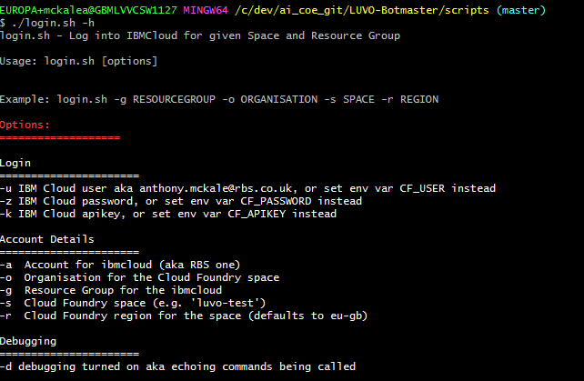
Bash Primer
Bash Scripts are plain text file
That start with a shebang*, that contain a series of actions to carry out (* will mention these later)

Slide 7
Bash Primer
Bash Terminology
man is the name of the manual command
bash is the name of the commadline
Environment variable is the name of the bash variable
shebang tells the system what to run script in ( aka bash or something else to execute a script)

Slide 8
The Basics of Bash
“The Basics of Bash” Table of Contents
History / Primer
Bash Basics
Bash Basics: Variables
Bash Basics: Maths
Bash Basics: Control Flow
Bash Basics: Functions

Slide 9
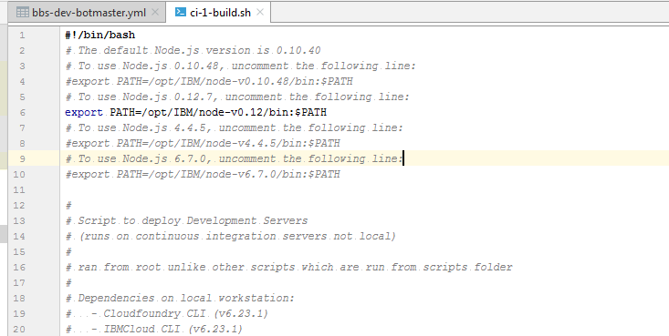
Bash Basics
Bash shebang
Tells bash what execute to use to run a script
This can be any executable aka node or perl etc

Slide 10

Bash Basics
Bash shebang
Node Example

Slide 11
Bash Basics
Environment variables these are the system variables
These are set with “setx” on windows Linux is a advanced topic (basically .profile + export)

Slide 12
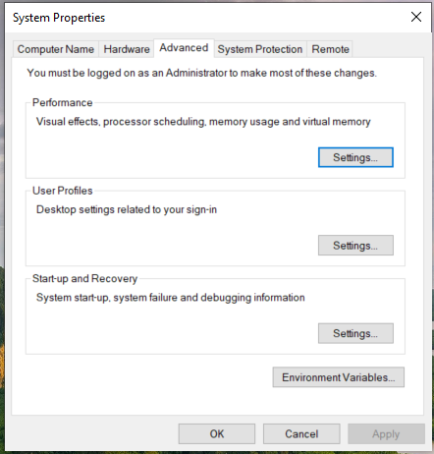
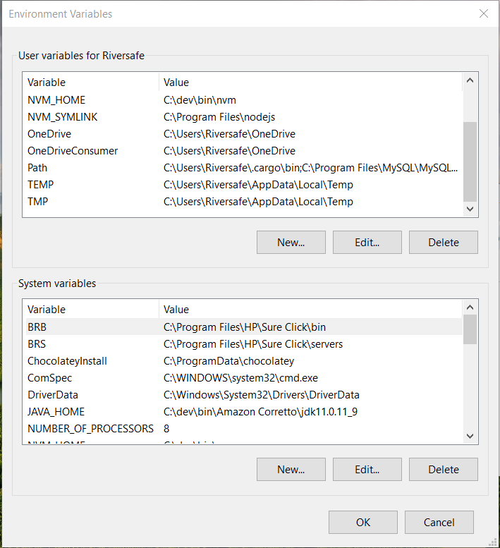
Bash Basics: Variables
How to set - Global Environment Variables - User Environment Variable Go to “System Properties -> Environment Variables”

Slide 13
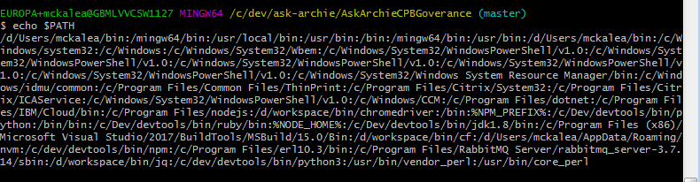
Bash Basics
Bash Path ($PATH environment variable)
This is the list of directories to look for executables echo $PATH (you can see I have a lot installed)

Slide 14
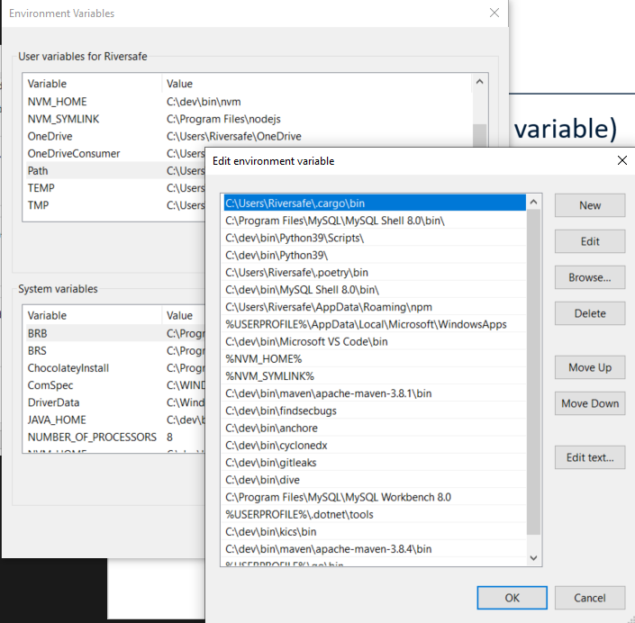
Bash Basics
Bash Path ($PATH environment variable)
WINDOWS VIEW

Slide 15
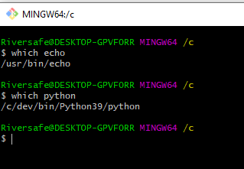
Bash Basics
Bash Path : finding out which executable your using
“which <EXECUTABLE_NAME>”

Slide 16
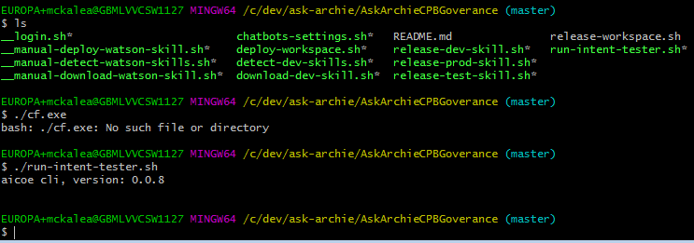
Bash Basics
Bash Path : ./ == run program in current directory ignoring $PATH
“./<EXECUTABLE_NAME>”

Slide 17
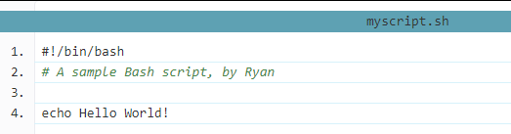
Bash Basics
Bash Commands: Just write them, see the `echo Hello World!`

Slide 18
Bash Basics
Bash Comments: # TEXT

Slide 19
Bash Basics: Variables
Bash Variables are very simple compared to other languages
Referenced with $ `echo $FOO`
When setting no $ `FOO=xxx`

Slide 20
Bash Basics: Variables
Bash Variables are very simple compared to other languages
Naming convention: uppercase ASCII case aka THIS_IS_A_VARIABLE
Variables can be placed anywhere in a script with the right interpolation ($`") FOO=McKale echo "this is mr $FOO" echo "this is mr ${FOO}"

Slide 21
Bash Basics: Variables
Bash Variables comes from: - Global Environment Variables System wide, all computer users
User Environment Variable User only
Session Variables set / unset during shell life Bash window/script only
Special Variable There be dragons…

Slide 22
Bash Basics: Variables
Escape codes in bash " and $ is a special character
echo "this costs $xxx" # looks for variable xxx
echo "this costs \$xxx" # doesn’t look for variable xxx
echo "this is "quoted"" # this has syntax error
echo "this is \"quoted\"" # this prints ‘this is "quoted"'
https://tldp.org/LDP/Bash-Beginners-Guide/html/sect_03_03.html

Slide 23
Bash Basics: Variables
Bash Variable Life Cycle:
Shell Opened Global / User variables copied into shell
When Shell variables change Setting variables ONLY affect current shell (not shared as standard) Global / User variables Not updated if change while shell open (needs special setx command to change them)
https://docs.microsoft.com/en-us/windows-server/administration/windows-commands/setx

Slide 24
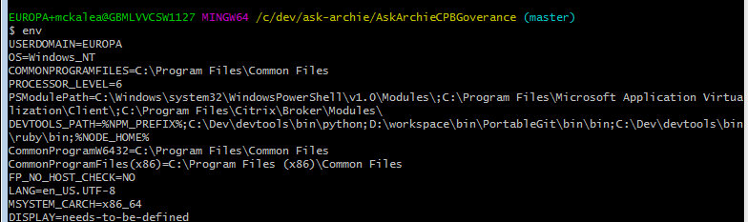
Bash Basics: Variables
To see all of your current variable use the “env” command WARNING: be careful with this command when screen sharing as you might have passwords in your environment variables !

Slide 25
Bash Basics: Variables
Special Variables : selection of preset variables
$0 - The name of the Bash script.
$1 - $9 - The first 9 arguments to the Bash script. (As mentioned above.)
$# - How many arguments were passed to the Bash script.
$@ - All the arguments supplied to the Bash script.
$? - The exit status of the most recently run process.
$$ - The process ID of the current script.
$USER - The username of the user running the script.
$HOSTNAME - The hostname of the machine the script is running on.
$SECONDS - The number of seconds since the script was started.
$RANDOM - Returns a different random number each time is it referred to.
$LINENO - Returns the current line number in the Bash script.

Slide 26
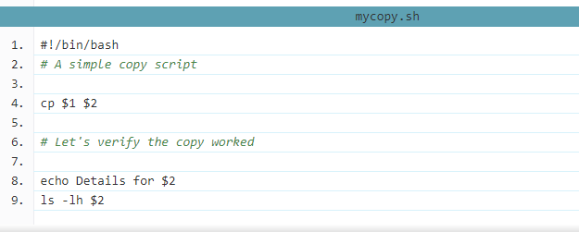
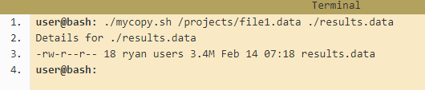
Bash Basics: Variables
Special Variables : Command line arguments
- $1 / $2 … for each argument

Slide 27
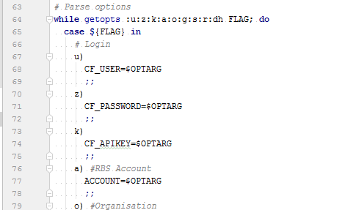
Bash Basics: Variables
Special Variables : Command line arguments function
For more advanced inputs with flags etc use getopts
https://linux.die.net/man/1/getopt

Slide 28
Bash Basics: Variables
Special Command line arguments function
For more advanced inputs with flags etc use getopts
https://linux.die.net/man/1/getopt

Slide 29
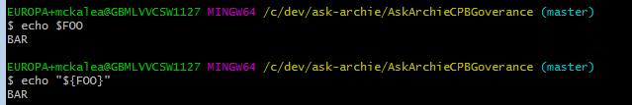
Bash Basics: Variables
Bash Variables setting and getting <NAME>=<VALUE>
echo $NAME echo "${NAME}"

Slide 30
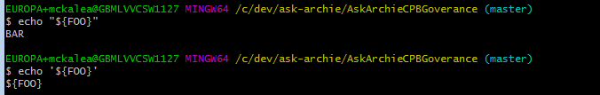
Bash Basics: Variables
Bash Variable Interpolation: - (') Single quotes will treat every character literally
- (") Double quotes will allow you to do substitution
echo "${NAME}"
echo '${NAME}'

Slide 31
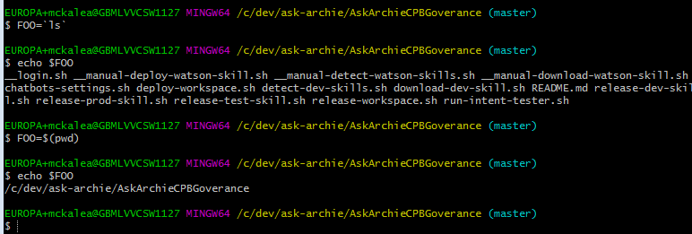
Bash Basics: Variables
Bash Variable Substitution: - (`) Backtick: run command and return output
- $() Quotes: run command and return output
FOO=`ls`
FOO=$(ls)

Slide 32
Bash Basics: Variables
Bash Variable Exporting: Setting variables ONLY affect current shell (not shared as standard)
You can set variables for child processes or scripts with “export <NAME>”
Advanced topic see: https://ryanstutorials.net/bash-scripting-tutorial/bash-variables.php

Slide 33
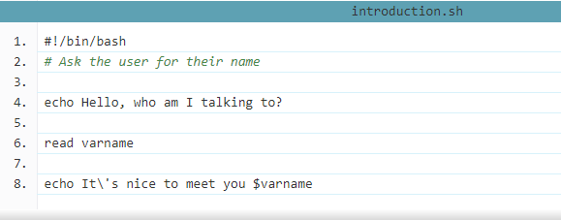
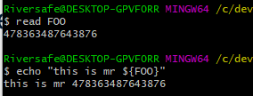
Bash Basics: Variables
Bash Variables from User Input Read user input, and put into <VAR_NAME> “read <VAR_NAME>”

Slide 34
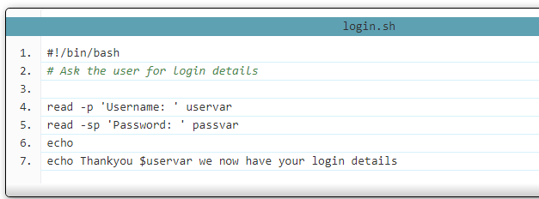
Bash Basics: Variables
Bash Variables from User Input with Prompt / Starting “read -FLAGS <VAR_NAME>”
common flags : -p which allows you to specify a prompt and
-s which makes the input silent

Slide 35

Bash Basics: Variables
(|) Passing STDXX Input from one program to another

Slide 36
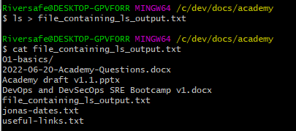
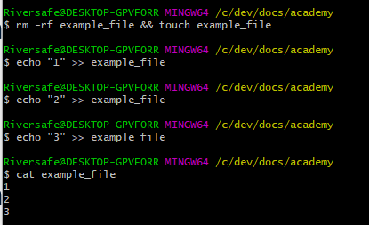
Bash Basics: Variables
(>) Passing STDXX Input from one program into file
(>>) Passing STDXX Input from one program append onto file

Slide 37
Bash Basics: Variables
(0>) Passing STDINPUT Input ?
(>) Passing STDOUT Input
(2>) Passing STDERR Input
(&>) Passing STDERR Input

Slide 38
Bash Basics: Variables PROCESS MANAGEMENT
Bash Variables from STDXX Input
Each process has inputs / output and error output
STDIN - /proc/<processID>/fd/0
STDOUT - /proc/<processID>/fd/1
STDERR - /proc/<processID>/fd/2
aka
VARNAME=`cat <SOME_FILENAME> | grep <SEARCH_TERM>`
VARNAME=`/dev/stdin | grep <SEARCH_TERM>`
* Advanced topic just worth knowing it’s possible

Slide 39
Bash Basics: Maths

Slide 40
Bash Basics: Maths
Bash Operators are very simple compared to other languages
Math works with let let FOO=1+1 echo $FOO
Operator | Operation
+, -, \*, / | addition, subtraction, multiply, divide
var++ | Increase the variable var by 1
var-- | Decrease the variable var by 1
% | Modulus (Return the remainder after division)

Slide 41
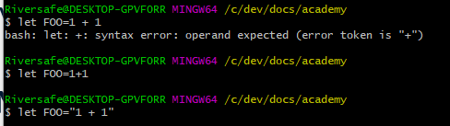
Bash Basics: Maths
Bash Operators are very simple compared to other languages
Math works with let NO SPACES WITH QUOTES! let FOO=1+1 echo $FOO

Slide 42
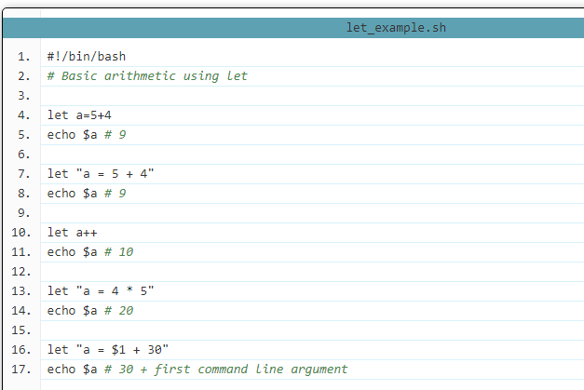
Bash Basics: Maths
Simple Example

Slide 43


Bash Basics: Maths
Simple Example 2
Inline Interpolation “$((EXPR))”
Length (#)

Slide 44
Bash Basics: Control Flow

Slide 45
Bash Basics: Control Flow
Bash Control Flow Operators are very simple compared to other languages
Control Flow Operators
Boolean Check Operators

Slide 46
Bash Basics: Control Flow
Bash is very simple compared to other languages
Control Flow Operators
If is (if then else fi)
Case is (case in ;; esac)
While is (while do done)
Until is (until do done)
For is (for var in do done)

Slide 47
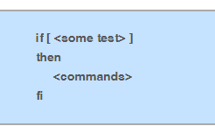
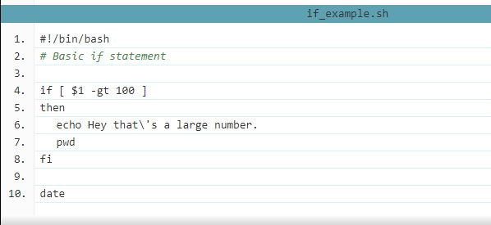
Bash Basics: Control Flow
Bash Control Flow Operator : Simple IF

Slide 48
Bash Basics: Control Flow
Bash Control Flow Operator : Simple Boolean Checks
Advanced topic see more here : https://linuxacademy.com/blog/linux/conditions-in-bash-scripting-if-statements/
Operator | Description
! EXPRESSION | The EXPRESSION is false.
-n STRING | The length of STRING is greater than zero.
-z STRING | The lengh of STRING is zero (ie it is empty).
STRING1 = STRING2 | STRING1 is equal to STRING2
STRING1 != STRING2 | STRING1 is not equal to STRING2
INTEGER1 -eq INTEGER2 | INTEGER1 is numerically equal to INTEGER2
INTEGER1 -gt INTEGER2 | INTEGER1 is numerically greater than INTEGER2
INTEGER1 -lt INTEGER2 | INTEGER1 is numerically less than INTEGER2
-d FILE | FILE exists and is a directory.
-e FILE | FILE exists.
-r FILE | FILE exists and the read permission is granted.
-s FILE | FILE exists and it's size is greater than zero (ie. it is not empty).
-w FILE | FILE exists and the write permission is granted.
-x FILE | FILE exists and the execute permission is granted.

Slide 49
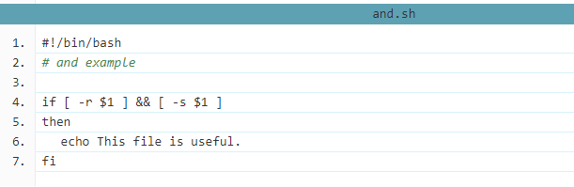
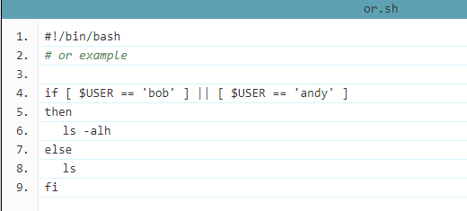
Bash Basics: Control Flow
Bash Control Flow Operator : Combining Checks with Boolean Operators
Main Operators:
And (&&)
Or (||)

Slide 50
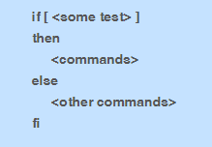
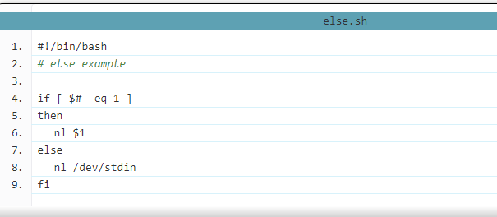
Bash Basics: Control Flow
Bash Control Flow Operator : Simple IF Else

Slide 51
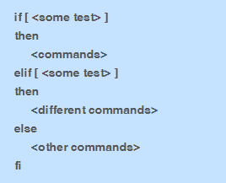
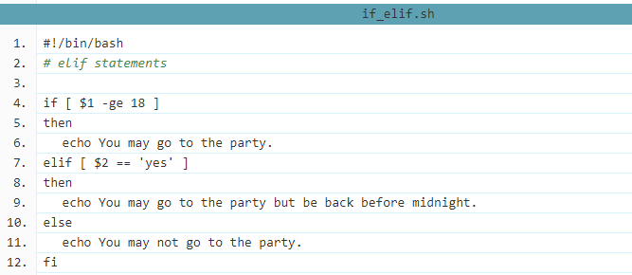
Bash Basics: Control Flow
Bash Control Flow Operator : IF Mutli Else

Slide 52
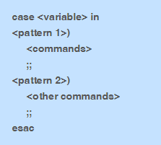
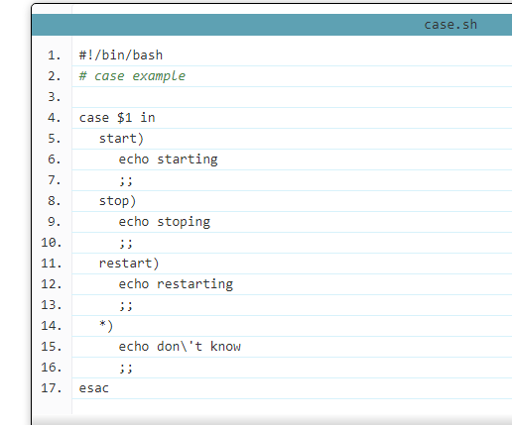
Bash Basics: Control Flow
Bash Control Flow Operator : Case
For comparing single variable multiple times

Slide 53
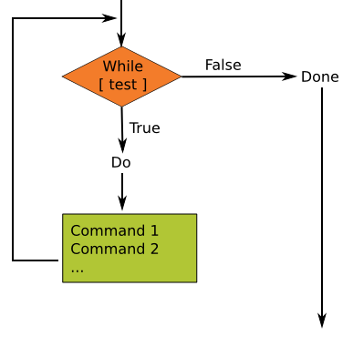
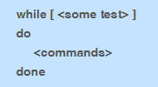
Bash Basics: Control Flow
Bash Control Flow Operator : While loop
For comparing doing actions until condition false * Warning: risk of infinite running loop

Slide 54
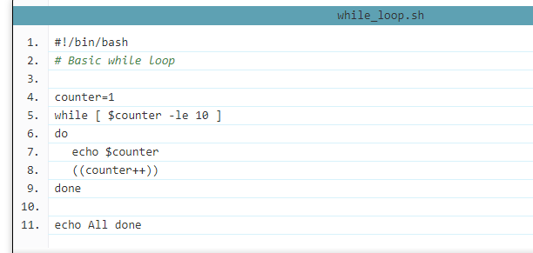
Bash Basics: Control Flow
Bash Control Flow Operator : While loop
Example

Slide 55
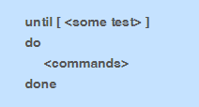
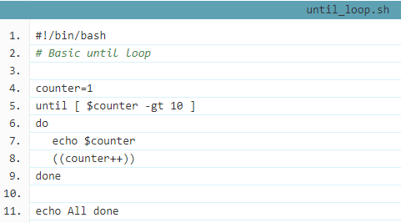
Bash Basics: Control Flow
Bash Control Flow Operator : Until loop
For comparing doing actions until condition true * Basically same as while

Slide 56
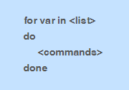
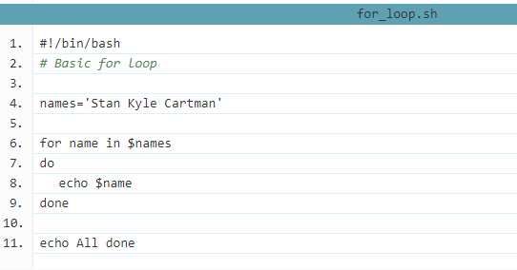
Bash Basics: Control Flow
Bash Control Flow Operator : For loop
For doing some thing for each member of a list

Slide 57
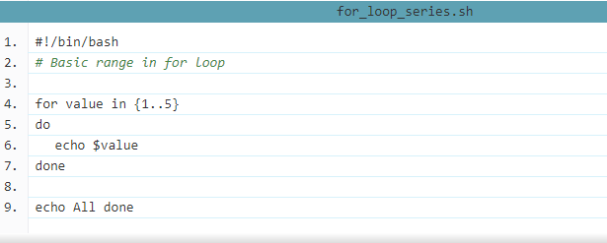
Bash Basics: Control Flow
Bash Control Flow Operator : For loop
Example with range of numbers {A..B} : creates array of number between A and B aka {1..3} would be [1,2,3]

Slide 58
Bash Basics: Control Flow
Bash Control Flow Operator : Stopping For loop
Special commands :
continue statement : tells Bash to stop running through this iteration of the loop and begin the next iteration.
break statement : tells Bash to leave the loop straight away

Slide 59
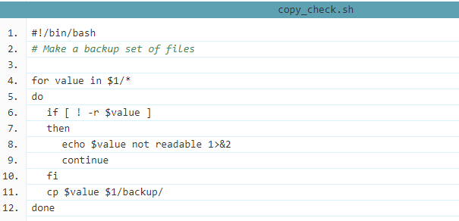
Bash Basics: Control Flow
Bash Control Flow Operator : Stopping For loop
Continue Example

Slide 60
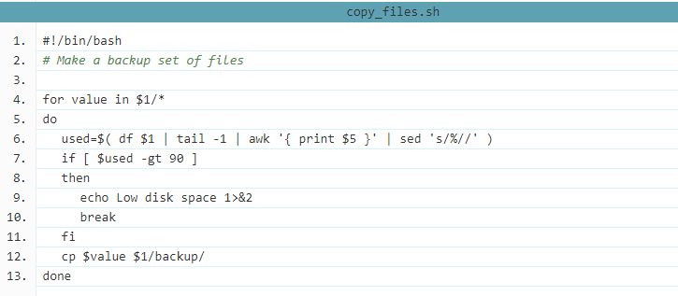
Bash Basics: Control Flow
Bash Control Flow Operator : Stopping For loop
Break Example

Slide 61
Bash Basics: Functions

Slide 62


Bash Basics: Functions
Bash Function are very simple compared to other languages
They have two formats
* I prefer the 2nd method but there is no difference

Slide 63
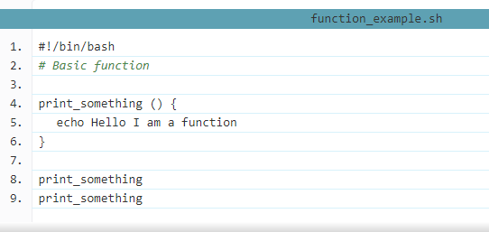
Bash Basics: Functions
Simple function example

Slide 64
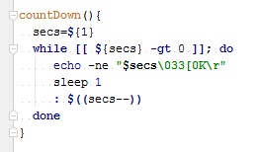
Bash Basics: Functions
Simple Timer function with arguments
Like scripts these are special variables $X parameters sent $1, $2 … `countDown 10` $1 == 10

Slide 65
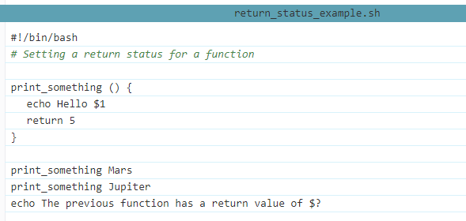
Bash Basics: Functions
Simple function with return
Rather pointlessly returns 5, I’d return 42 personally

Slide 66
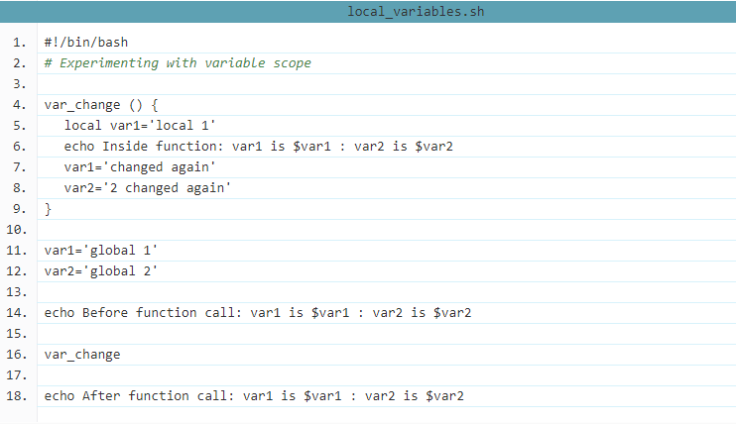
Bash Basics: Functions
Simple function with local variables “local <NAME>=<EXPR>” die when variable returns

Slide 67

Bash Basics: Colours
Bash Colours done via term signals (\eNUMBERm)
https://misc.flogisoft.com/bash/tip_colors_and_formatting
echo -e "\e[31mHello World\e[0m"

Slide 68
Intermission
Tea
Cake
Questions ?
Points:
- Question ?

Slide 69
Further Information
Links
Colour https://misc.flogisoft.com/bash/tip_colors_and_formatting
Bash man https://ss64.com/bash/
This tutorial https://ryanstutorials.net/bash-scripting-tutorial/

Slide 70

Questions ?
I’ve been Anthony M^{c}Kale “Wizard without Portfolio” Fixer-Upper of Broken things, and creator of time-constrained workable Fudges for 15 years. Email : anthony@zapper.hodgers.com

